Slide 1
Sai Services DRO
Welcome To Sai Services
Having a strong commitment to supplying high-efficiency products like DRO System that has created a significant market position as a prominent Manufacturer, Supplier, Trader and Importer in the industry, Sai Services is bent on assuring an excellent quality standard of machines and achieving admirable recognition with simple yet innovative design along with outstanding workmanship.
Its comprehensive product line spans DRO System (Digital Readout System) which ensures in operating, sleeker appearance, clear display, incorporation of a few important buttons(keys), etc., therefore which is in consonance with global standards and distinct features.

Slide 2
Most Popular Products
Magnetic Linear Scale
Aluminum Couplings
Optical Linear Scale
Magnetic Linear Encoder
Digital Readout System
Profile Projector
Manufacturer, Supplier, Trader and Importer of DRO (Digital Readout System), Linear Glass Scale, Magnetic Tape, Magnetic Scale and Encoder.

Slide 3
Digital Readout System
Digital Readout System (DRO)
We have carved a niche as a key Digital Readout System Manufacturer, Supplier, and Trading Company, based in India. Our range of DRO System is a suitable for digital measuring and video measuring system. With high efficiency of analyzing and processing 2D measuring data, this range is extensively used in the tool microscope, profile projector, video measuring system and varied other two-dimension measuring instrument. Our products are available with circular drilling function that enables them to mechanically calculate the place of the hole according to the inputted data.
Key Features :Three –axis 24-bit reversible counter
Slope calculation
Z-axis combination calculation
Linear scale error compensation
Numerical filtering function
Sai Services Offers :Sai Brand ASD 10 Digital Readout System DROM
ADR 10 series-2 axis Digital Readout System DRO
ADR 10 series-3 axis Digital Readout System DRO
ADR 10 series-4 axis Digital Readout System DRO

Slide 4
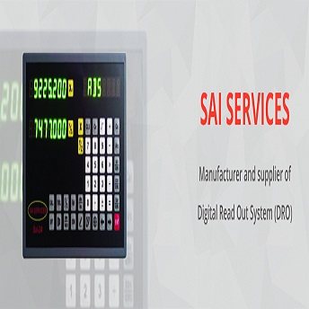
Digital Readout System Manufacturer. Sai Services are top most Manufacturer of Digital Readout System DRO get excellent services at best prices.

Slide 5
Optical Linear Scale
Optical Linear Scale
Our immense domain expertise and market knowledge assist us to manufacture and supply the finest quality array of Optical Linear Encoder. It is available in different specifications to meet the exact needs of the clients. Our skilled professionals manufacture this encoder by making use of the finest quality raw material and component at our advanced production unit. This Optical Linear Encoder is delivered to the clients at market leading prices.
Sai Services Offers :
ASD 4 Slim Body Optical Linear Scales
ASD 5 Bold Body Optical Linear Scales
ASD 6 Bold Body & Long Measuring Optical Linear Scales

Slide 6
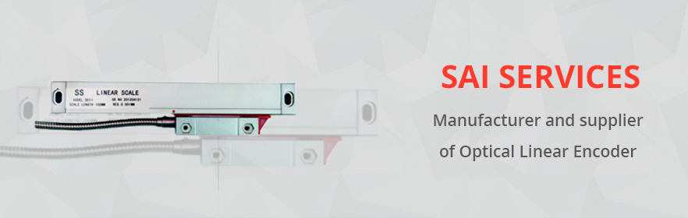
Find here details of companies Linear Scale Manufacturer? Sai Services DRO Provides the best of Optical Linear Scale & Linear Scale, at best price in India for more details contact Sai Services.

Slide 7
Linear Magnetic Encoder
Magnetic Linear Encoder
Sai Services develops and manufactures high-precision magnetic tape for measuring lengths with different code patterns and pole pitches for numerous industrial applications. The tape is offered in multiple widths from 5 to 25 mm and with the option to code multiple tracks.
Key Features :Tape in flat aluminum profile
Use with MLS1 Reader Head Sensors
Wide range of available resolution up to 1 µm
Protection class IP67
Measuring lengths are up to 100 meter
Best technology in small dimensions
Stainless steel cover protect
Sai Services Offers :
MLS 100 Series Magnetic Linear Encoders
MLS 200 Series Magnetic Linear Encoders
B Series Magnetic Tape
Carrier Profiles Magnetic Linear Encoders
MLC 300 Compact Scale System Magnetic Linear Encoders
MLC400 Series Self Aligned Systems Magnetic Linear Encoders

Slide 8
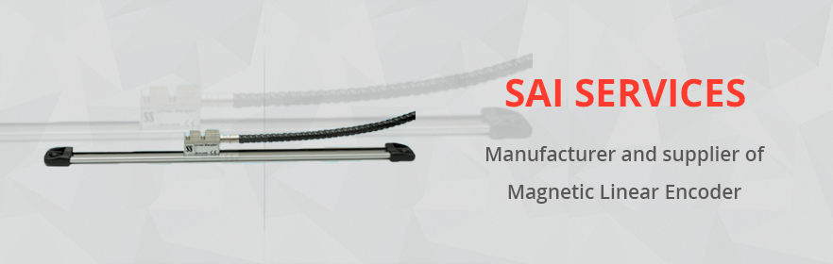
Looking for best Linear Magnetic Encoder Manufacturer? Sai Services DRO is Linear Magnetic Encoder Manufacturer in India, develops high-precision magnetic tape for measuring length.

Slide 9
Profile Projector
We are a renowned Manufacturer, Exporter, and Supplier of Profile Projector. The Profile Projector we offer is efficient, reliable and durable. The Profile Projector can be availed from us in various specifications as per the needs. We supply Profile Projector at competitive prices all around the world.
The highly demanded Profile Projectors are manufactured with the best technology and high-quality raw materials. These Profile Projectors are highly effective in a number of applications. In addition, we offer these Profile Projectors at extremely affordable prices. ...
Sai Services Offers :
Profile Projector DRO DC 3000 SAI SERVICES
Profile Projector PRO300H SAI SERVICES
Profile Projector Machine
Optical Profile Projectors
Auto-L-Check
Diffusion Measuring Equipments
Telescope
Optical Components

Slide 10
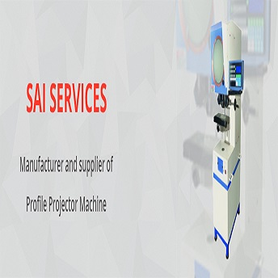
Wholesale Trader of Profile Projector Manufacturer. Sai Services DRO is Manufacturer of Profile Projector. Profile Projector can be availed from us in various specifications as per need.

Slide 11
About
About Sai Services
Located in Pune, India, we, "Sai Services" are a well recognized engineering house engaged in manufacturing, supplying, importing, trading in a wide range of Shaft Encoders, Linear Magnetic Scale and Tapes, DRO (Digital Readout System), etc., which guarantee for the optimum performance, a great level of rigidity, reliable operation and outstanding efficiency. Our offered gamut of products like Linear Magnetic Scale and Tapes are widely used in diverse industrial applications and processes. All the products meet the International Quality Standards and are acknowledged for their durability, excellent finish, sturdy designs and rigid construction and long service life. Along with this, we also provide services for installation, operational training and on-site support of our products. The company contributes greatly to the evolution of the industry as well as to manufacturing of Shaft Encoders which facilitate and optimise the movement of various pieces of industrial devices & equipment.

Slide 12
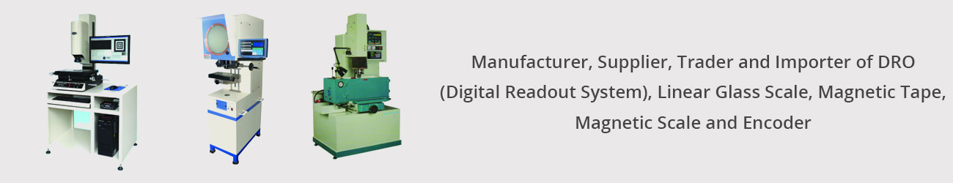
Over the last several years, the company has achieved a milestone for serving as a reliable Shaft Encoders Manufacturer and carrying on with its tradition of assuring of supreme quality. With the mission to streamline the production & design of Linear Magnetic Scale and Tapes, meeting the domestic & overseas clients' demands and application requirement. With the cooperation of our active and hardworking team of professionals, our company has succeeded to gain a distinctive recognition among our competitors. In addition to this, we have set an advanced infrastructure that is well equipped with latest technologies has helped us to win the trust of many leading companies and brands in a very limited time span. Our strong vendors base supports us to manufacture an unbeatable line of Shaft Encoders and other products at the competitive prices which are used for wide industrial consumption. Owing to our ethical business policies, client centric approach, competitive prices, we have succeeded to add a number of clients with us.

Slide 13
Contact US
Registered office
CTS 2743, Sayli Apartment, Shikshak Society, Talegaon-Dabhade, Tal-Mawal, Pune - 410506
020-65117477
ajay.desai@saidroindia.com
Branch Office
Shriji Terace Plot No 53, Shop No 5, Shivsai Chowk Purna-nagar, Behind to RTO Office Chikhali, Pune - 410019
+91-9225207477 / 020-65117477
info@saidroindia.com

